Slide 1

APPLICATION PENETRATION TESTING
Author: Herbert H. Thompson
Presentation by:
Nancy Cohen

Slide 2
Overview
What is penetration testing
Why do penetration testing
Examples of penetration tests
Components of software security testing
Conclusion
Questions
Notes:
Organizations will implement internal or external penetration tests to simulate real-world attacks on their systems. The goal is to expose security gaps and demonstrate the effectiveness (or ineffectiveness) of their security measures.

Slide 3
What is Penetration Testing?
Software testing that is specifically designed to hunt down security vulnerabilities
In computer software, a security vulnerability is a software bug that can be used to violate security.
Notes:
The intent behind security testing is to find those security vulnerabilities that exist in an application.
A bug could include an inadequate user authentication process, the potential for a buffer overflow

Slide 4
Why Do Penetration Testing?
Software can be correct without being secure
  Software can perform every specified action flawlessly and still be exploited by a malicious user
  Security bugs are typically hidden in nature
Companies need to protect information and business assets against hacking and data theft
Notes:
Software can perform exactly according to the specification and still not be secure. Security bugs are not obvious like functional application bugs. Companies need to protect the confidentiality of their customers’ information.

Slide 5
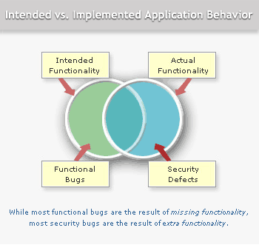
Notes:
Intended functionality
Perfect behavior
traditional software bugs are found here
Actual functionality
As coded into the product by developers
The software does extra things that it is not supposed to do
Security vulnerabilities exist here
Behaviors that are not supposed to happen are often masked by the fact that the software also satisfied its requirements.
Intersection of intended and actual functionality
Behaviors coded exactly as intended without insecure side effects

Slide 6

Approaches for Penetration Testing
Outsider with zero knowledge
Insider with limited knowledge – valid account with restrictive privileges
Insider with full knowledge – administrator account
Notes:
Techniques and skills needed to find security problems are drastically different from those for locating functional flaws.
It requires out of the box thinking and a process that tests against risks rather than traditional testing goals.

Slide 7
Examples of Penetration Tests
Parameter tampering
Known vulnerabilities
Brute force
Session hijacking
Information gathering
Notes:
Buffer overflow – data sent as input to the server that overflows the boundaries of the input area, thus causing the server to misbehave. Buffer overflows can be used to make the server run a code sent into the overflowed buffer.
Parameter Tampering – changing the data within a parameter sent from one Web page to another in a way that would alter the behavior of the latter page.
Known vulnerabilities – using known vulnerabilities and exploits on commercial software platforms. This class holds dozens of attacks that are widely known and published.
Brute force – attacks designed to steal of passwords or session ids, by means of enumerating a large number of password/session ID options.
Session hijacking – capturing the session of another user, which in effect means being able to impersonate the user in the eyes of the application.

Slide 8
Creating a Security Testing Project
Threat Models
Test plan
Test cases
Problem reports
Postmortem

Slide 9
*Threat Modeling
A way of categorizing and analyzing the threats to an application
What information will a threat model help to provide?
  Which assets need protection
  What threats is the application vulnerable to
  How important or how likely is each threat
  How can the threats be mitigated
Notes:
Assets: hardware, software, and data on a computer or network

Slide 10
STRIDE - Model of Threat Categories
Spoofing identity - Illegal use of another person's authentication information, such as a user name or password.
Tampering with data - malicious modification of data
Repudiation - Users deny performing an action
Information Disclosure - exposure of information to unauthorized individuals
Denial of Service - explicit attempt to prevent legitimate users from using a service or system.
Elevation of Privilege - an unprivileged user gains privileged access
Notes:
Helps in the development of threat models. These are items that should be taken into consideration.

Slide 11
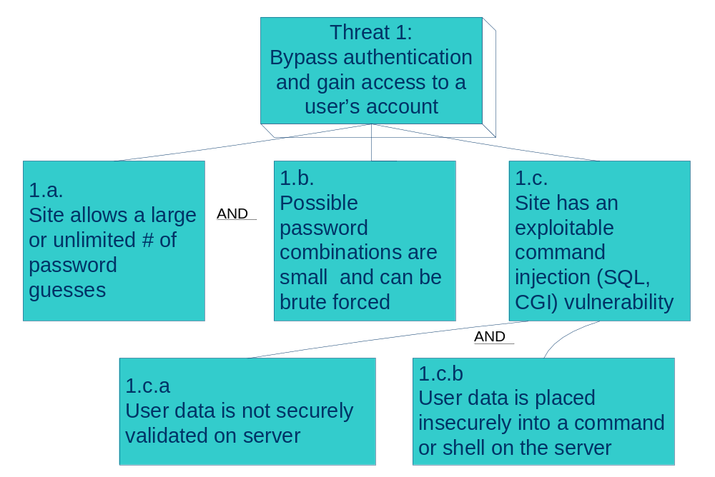
Partial Threat Tree
Notes:
At a high level the threat is that an attacker will bypass the authentication or brute-force the password field for a known user.
This figures shows the conditions necessary to realize this threat.
For example, if both conditional 1.a. and 1.b hold, then can then gain unauthorized access to a user’s account.

Slide 12
*Build a Test Plan
Includes high level overview of test cases
Identifies components to be tested
States how exploratory testing will be done
  Test design and test execution at the same time
Plan must also address
  Logistics
  Deliverables
  Test cases and tools
Notes:
Logistics: Project schedule, People, Resources, Equipment, Testing schedule
Deliverables: Description of all deliverables and their associated timetable. Includes Problem reports & final report
Test Cases:
Based on the threat model for application
Test cases tied to application risks
Identifies tools required to conduct testing
Includes identification of automated testing tools

Slide 13
*Execute Test Cases
Dependency testing
User interface testing
Design testing
Implementation testing
Notes:
Test cases fall into one of 4 categories

Slide 14
Dependency Testing
Dependency testing exposes insecurities related to external resources
  File systems
  Registry
  External libraries
Types of insecurities that can arise
  Denying the application access
  Tampering with and corrupting data
Notes:
Applications often rely on external resources to behave securely.

Slide 15
User Interface Testing
Parameter tampering testing
  Changing the data within a parameter sent from one Web page to another
Command injection testing
  Manipulating input data sent to a Web server
Buffer overflow testing
  Data sent as input to the server that overflows the boundaries of the input area
Notes:
User interface testing delivers input to the software the way developers anticipated via the command window, text fields, buttons, etc. The objective here is to test corrupt and unanticipated inputs.

Slide 16
Design Testing
Helps to identify design errors
  Unsecured ports
  Default accounts
Notes:
Privileges: Each user and each program should operate by using the fewest privilege possible. In this way, the damage from an inadvertent or malicious attack in minimized.
Incomplete Mediation: Every access must be checked (direct access attempts (requests) as well as attempts to circumvent the access checking mechanism must be considered.

Slide 17
Implementation Testing
TOCTOU – time-of-check-to-time-of-use
  A time gaps exists between when an application checks security on a particular function or piece of data and when that privilege is exercised
Notes:
Even if an application’s design is secure, many bad things can occur when developers make specific implementation choices or errors.
Example – suppose a user is requesting access to a file. While the mediator is checking access rights for the file, the user could change the file name. The mediator approves the request based on the initial information provided. The mediator would now send the now-modified descriptor to the file handler. Between the time the access was checked and the time the result of the check was used, a change occurred, invalidating the result of the check.

Slide 18
*The Problem Report
Must include
  Reproduction steps
    List the steps that another tester/developer must follow to reproduce the failure
  Severity
    What is the potential result of the failure
  Exploit scenarios
    The specific sequence of things an attacker can do to take advantage of a security flaw and the consequences of doing so

Slide 19
*Postmortems
Includes a discussion by the testing team of the bugs found
Identifies improvements to the testing process so that bugs are found sooner in future security testing
Performed after a project is complete
Performed periodically for released products when bugs are uncovered in the field

Slide 20
Conclusion
Functional software testing is not enough
Security testing must be included in the software development process.
Software quality and software security are intertwined - you can't have one without the other.

Slide 21
Questions

